Slide 1
CMPE343 More Sample Questions
Prof Dr Melike Şah Direkoğlu

Slide 2
Draw the Entity Relationship Diagram (ERD) Be careful about cardinality constraints, weak entities, total participation and generalization.
Food contains information about recipe, name, food_id and price.
Food may use several ingredients. Amount information is also associated with the use.
Each ingredient has a calorie, ingredient_id and name.
Main course (main food) is a type of food.
Starter is a type of food.
There is a menu order. Menu order contains a menu_id, order_id and order_amount. Each menu may include one to many main course items and zero to many starter items.
Sales contain information about date, total price, and sales_id.
Sales depends on the menu order through daily sales. It is possible that there are zero to many sales daily.

Slide 3
Consider the Following Tables:
Hotels: Hotel name, address, daily price, hasActivity
Activities: Activity name, season
- Using DDL syntax, create Hotels and Activities tables.
- Using DML syntax, add two records into Hotels and Activities tables.
- Using DML syntax, add a new column called activityDetail (i.e. varchar(255)) into the Activities table.

Slide 4
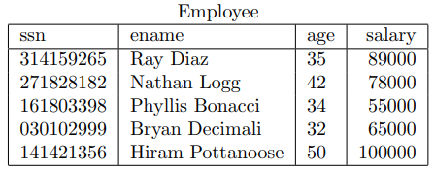
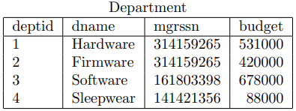
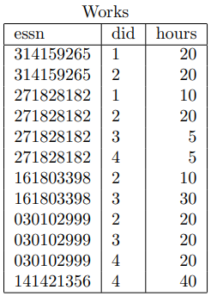
Use the tables below for the following SQL queries

Slide 5
Q1. Find the employee name and salary of managers under age 40.
Q2. List the departments in decreasing budget value.
Q3. Retrieve employee ids of people that work either 10 hours or 20 hours.
Q4. Find departments with a budget range of 80000 and 500000 (including both ranges).
Q5. Find employee names not having a salary between 55000 and 65000.
Q6. Find employee names that contain the substring ‘an’ in their names.
Q7. Find employee names that ends with ‘i’.
Q8. Display unique working hours.
Q9. Display employee name and department name, and order the results in alphabetical department name order (hint: use ssn and mgrssn columns to match tables).
Q10. Display employee name and hours (worked) for each employee. Order the results based on did column first and then in decreasing hours column as the second criterion. (hint: use ssn and essn columns to match tables).

